Slide 1
CEF440: INTERNET PROGRAMMING AND MOBILE PROGRAMMING
TASK I1:
Presented by Group 11

Slide 2
What is requirement gathering
Requirement gathering is the process of identifying your project’s exact requirements from start to finish.
How long will our project schedule be?
Who will be involved in the project?
What risks may we face in this project?
Studying the current system

Slide 3
Project Initiation document(PID) and PID Template(1/2)
A project initiation document (PID) is a type of document that project managers create before they begin a project.
A project initiation document (PID) template is a reusable outline of a project initiation document.

Slide 4
Project Initiation document(PID) and PID Template(2/2)
Why use the PID template
Establishes consistency across all projects.
Allows for customization for specific teams.
Quickly provide context for stakeholders
What’s included in a project initiation document template?
Project goals or objective
Success metrics
Project scope
Communication plan
Resourcing strategy

Slide 5
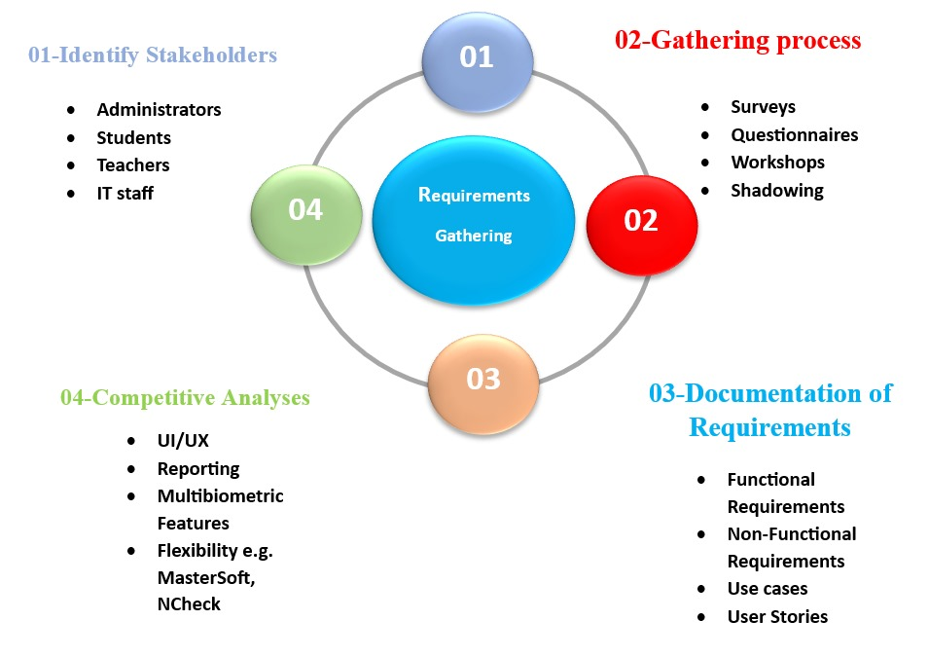

Slide 6
Requirement gathering (1/5)
Identify stakeholders
Administration
Teachers
Students
IT Department

Slide 7
Requirement gathering(2/5)
Gathering Process
Shadow:
Counting heads
Calling out names
Writing names
Printed Attendance sheets
Workshop:
Enrollment module.
Attendance recording module
Reporting and monitoring module
Performance
Scalability and Customization

Slide 8
Requirement gathering process(3/5)
Questionnaires and Surveys.
We collected the following information and obtain some questions like:
Does your faculty currently has a student attendance system in place?
If yes, what type of system is currently used?
How satisfied are you with the system?

Slide 9
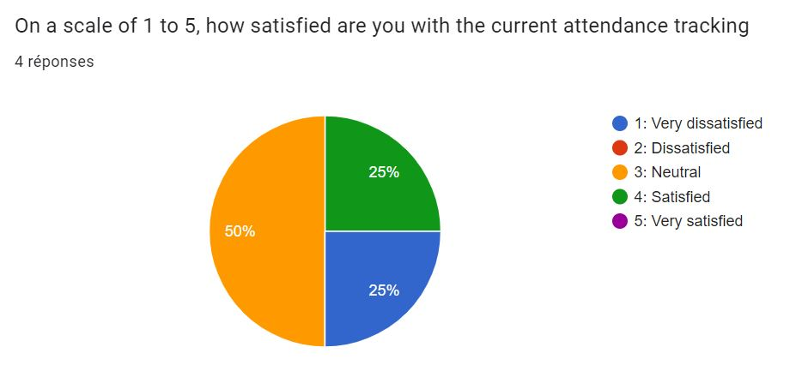
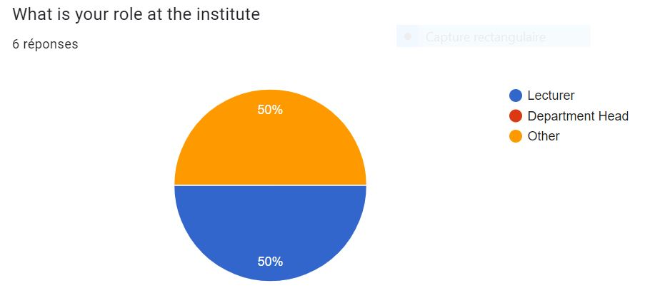

Slide 10
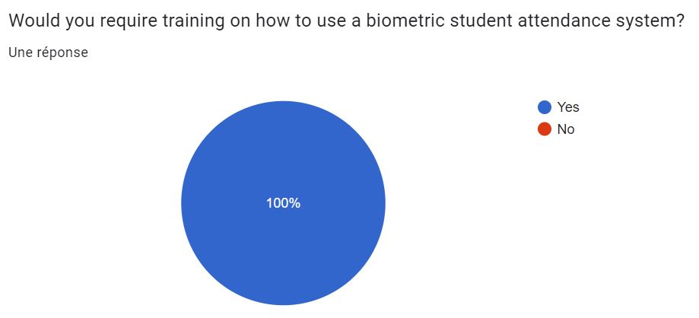
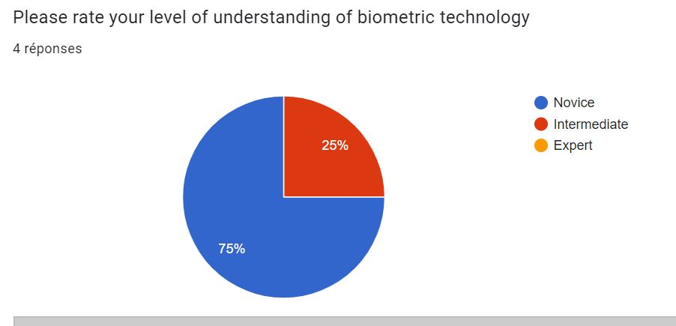

Slide 11
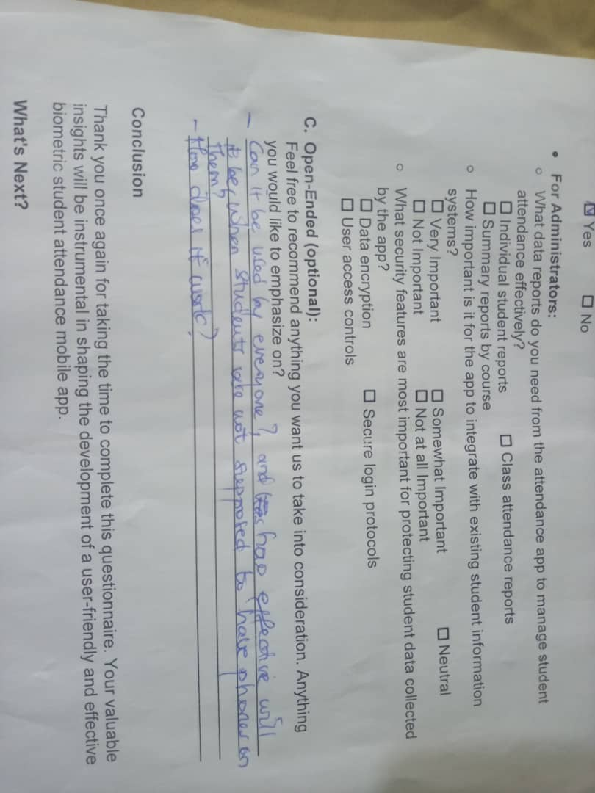
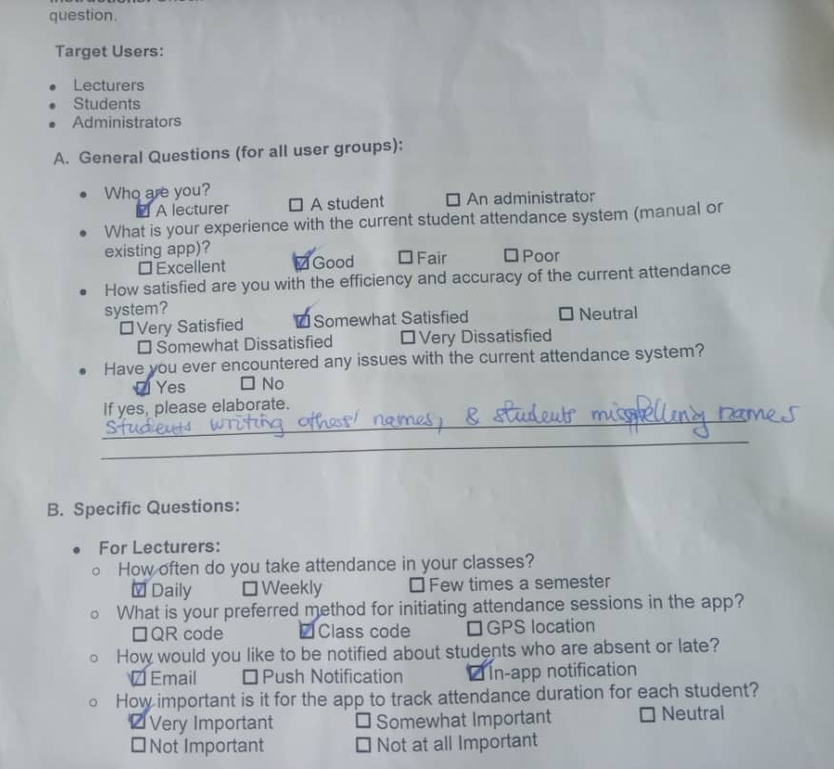

Slide 12
Requirement gathering process(4/5)
Workshop and Brainstorming Session
We brainstormed to gather insights, identify requirements, and generate innovative ideas for the design and implementation of the Biometric student’s Attendance.

Slide 13
Requirement gathering process(3/5)
Requirement Documentation
Use cases
User stories

Slide 14
Conclusion
By following these steps, you'll have a solid foundation of user needs and functionalities to guide the development of your biometric student attendance mobile app.

Slide 15
THANK YOU

